Slide 1
You had studied English before you moved to New York. Had you studied English before you moved to New York? You had not studied English before you moved to New York.
Thursday, September 18th 2014
Past Perfect FORM

Slide 2
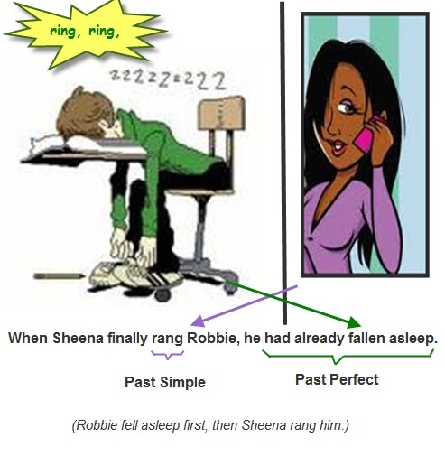

Slide 3
USE 1. Completed Action Before Something in the Past
The Past Perfect expresses the idea that something occurred before another action in the past. It can also show that something happened before a specific time in the past.
Examples:
I had never seen such a beautiful beach before I went to Kauai.
I did not have any money because I had lost my wallet.
Tony knew Istanbul so well because he had visited the city several times.
Had Susan ever studied Thai before she moved to Thailand?

Slide 4
USE 2 .Duration Before Something in the Past (Non-Continuous Verbs)
We use the Past Perfect to show that something started in the past and continued up until another action in the past.
Examples:
We had had that car for ten years before it broke down.
By the time Alex finished his studies, he had been in London for over eight years.
They felt bad about selling the house because they had owned it for more than forty years.

Slide 5
PRACTICE
1) When I arrived at the cinema, the film had started (start)..
2) She___ ____ (live) in China before she went to Thailand
3)After they ___ ___ (eat) the shellfish, they began to feel sick.
4)Julie didn’t arrive until after I ___ ___ (leave)..
5)The garden was dead because it ___ ___(be-neg) dry all summer
6)He ___ ___(meet) her somewhere before..

